Slide 1
UML Modeling

Slide 2
UML (Unified Modeling Language)
UML (Unified Modeling Language) is a standard language for specifying, visualizing, constructing, and documenting the artifacts of software systems.
UML is a pictorial language used to make software blueprints.
UML diagrams are not only made for developers but also for business users, common people, and anybody interested to understand the system. The system can be a software or non-software system.

Slide 3
UML MODEL
It is very important to distinguish between the UML model. Different diagrams are used for different types of UML modeling. There are three important types of UML modeling.

Slide 4
UML MODEL
Structural Modeling
Structural modeling captures the static features of a system. They consist of the following −
Classes diagrams
Objects diagrams
Deployment diagrams
Component diagram

Slide 5
UML MODEL
Behavioral Modeling
Behavioral model describes the interaction in the system. It represents the interaction among the structural diagrams. Behavioral modeling shows the dynamic nature of the system. They consist of the following
Activity diagrams
Interaction diagrams
Use case diagrams

Slide 6
UML MODEL
Architectural Modeling
Architectural model represents the overall framework of the system. It contains both structural and behavioral elements of the system. Architectural model can be defined as the blueprint of the entire system. Package diagram comes under architectural modeling.

Slide 7
Basic Notations
Structural Things
Structural things define the static part of the model. They represent the physical and conceptual elements. Following are the brief descriptions of the structural things.

Slide 8
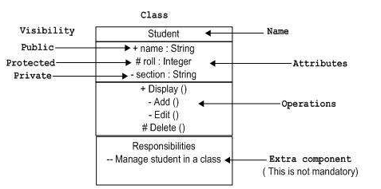
Basic Notations
Class Notation
UML class is represented by the following figure. Class represents a set of objects having similar responsibilities.

Slide 9
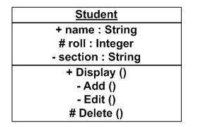
Basic Notations
Object Notation
The object is represented in the same way as the class. The only difference is the name which is underlined as shown in the following figure.

Slide 10
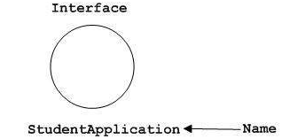
Basic Notations
Interface Notation
Interface is represented by a circle as shown in the following figure. It has a name which is generally written below the circle.

Slide 11
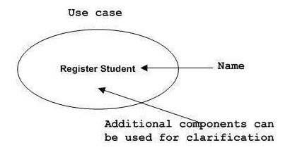
Basic Notations
Use Case Notation
Use case is represented as an eclipse with a name inside it. It may contain additional responsibilities.

Slide 12
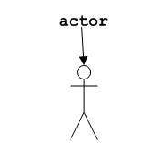
Basic Notations
Actor Notation
An actor can be defined as some internal or external entity that interacts with the system.

Slide 13

Basic Notations
Initial State Notation
Initial state is defined to show the start of a process. This notation is used in almost all diagrams.

Slide 14

Basic Notations
Final State Notation
Final state is used to show the end of a process. This notation is also used in almost all diagrams to describe the end.

Slide 15
Basic Notations
Relationships
A model is not complete unless the relationships between elements are described properly. The Relationship gives a proper meaning to a UML model. Following are the different types of relationships available in UML.

Slide 16
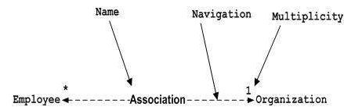
Basic Notations
Association Notation
Association describes how the elements in a UML diagram are associated. In simple words, it describes how many elements are taking part in an interaction.

Slide 17

Basic Notations
Generalization Notation
Generalization describes the inheritance relationship of the object-oriented world. It is a parent and child relationship.

Slide 18
Class Diagram
Class diagram is a static diagram. It represents the static view of an application. Class diagram is not only used for visualizing, describing, and documenting different aspects of a system but also for constructing executable code of the software application.

Slide 19
Class Diagram
Purpose of Class Diagrams
Analysis and design of the static view of an application.
Describe responsibilities of a system.
Base for component and deployment diagrams.

Slide 20
Class Diagram
Class Name
Following rules must be taken care of while representing a class:
A class name should always start with a capital letter.
A class name should always be in the center of the first compartment.
A class name should always be written in bold format.
An abstract class name should be written in italics format.

Slide 21
Class Diagram
Attributes characteristics
The attributes are generally written along with the visibility factor.
Public, private, protected and package are the four visibilities which are denoted by +, -, #, or ~ signs respectively.
Visibility describes the accessibility of an attribute of a class.
Attributes must have a meaningful name that describes the use of it in a class.

Slide 22
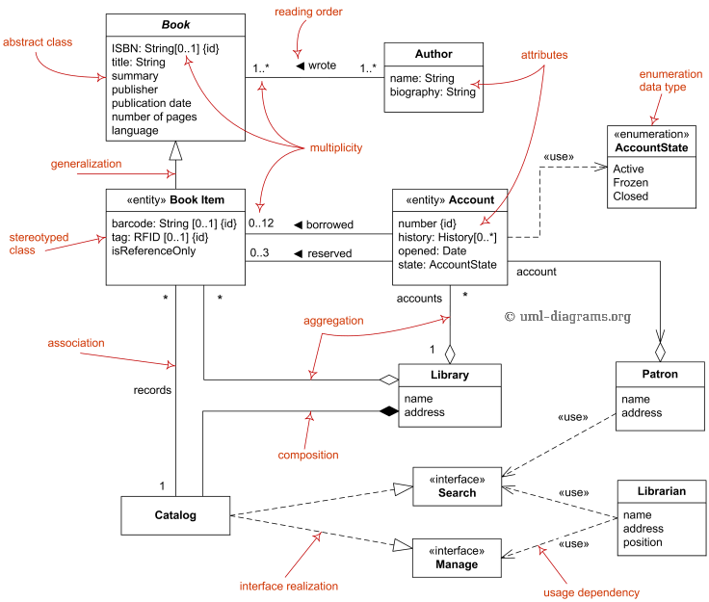
Class Diagrams

Slide 23
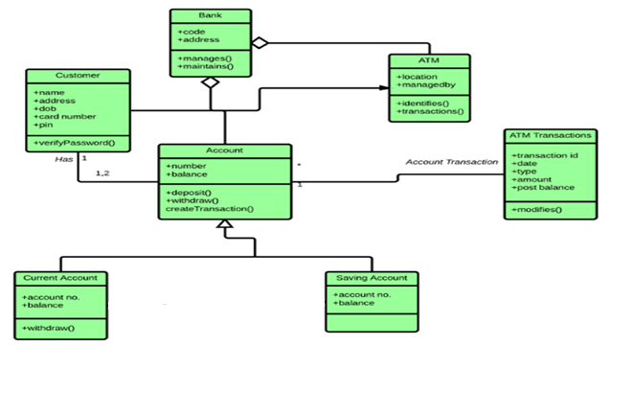
Class diagram for an ATM system

Slide 24
Use Case Diagrams
Only static behavior is not sufficient to model a system rather dynamic behavior is more important than static behavior. case diagram is dynamic in nature, there should be some internal or external factors for making the interaction.
The diagram is used to model the system/subsystem of an application. A single use case diagram captures a particular functionality of a system.
Hence to model the entire system, a number of use case diagrams are used.

Slide 25
Use Case Diagrams
Components of use case diagrams
Actors
System
Relationships
Use cases
Notes:
We can say that use cases are nothing but the system functionalities written in an organized manner. The second thing which is relevant to use cases are the actors. Actors can be defined as something that interacts with the system.
Actors can be a human user, some internal applications, or may be some external applications.

Slide 26
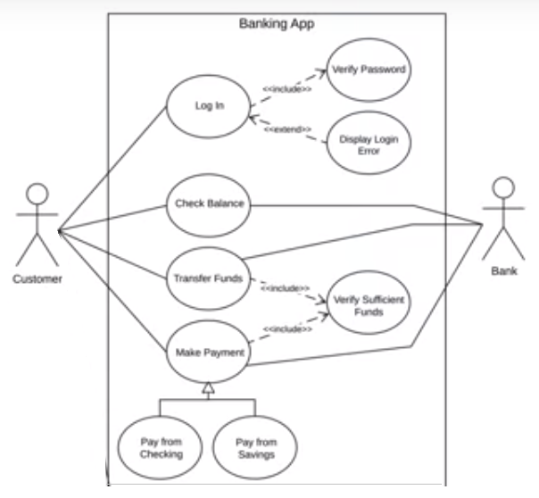
Use Case Diagrams

Slide 27

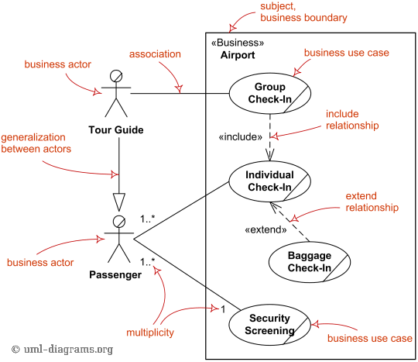
Use Case Diagram

Slide 28
The Sequence Diagram
The sequence diagram captures the time sequence of the message flow from one object to another.
Show how objects and classes interact with each other.
They show the sequence of events.

Slide 29
The Sequence Diagram
Actors
Objects
Lifeline
Message
  Call message
  return message
  self message
  create message
  destroy message
Activation boxes

Slide 30
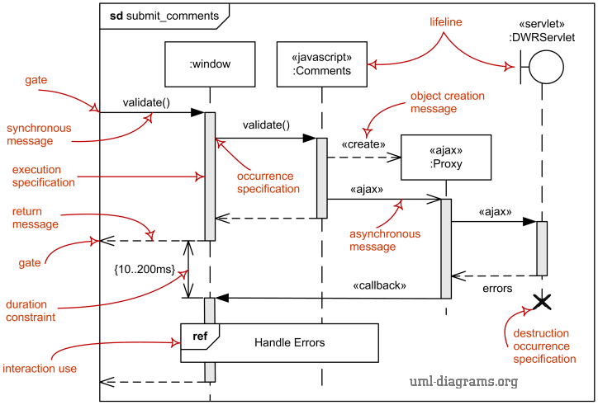
Sequence Diagram

Slide 31
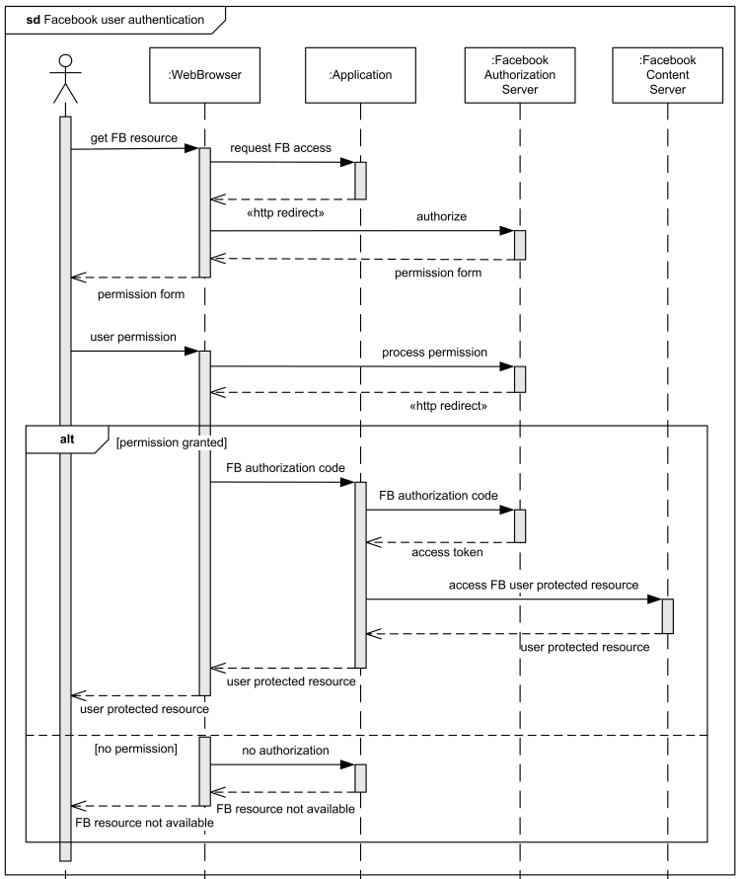

Slide 32
State Transition Diagram
It describes different states of a component in a system. The states are specific to a component/object of a system.
A Statechart diagram describes a state machine. State machine can be defined as a machine which defines different states of an object and these states are controlled by external or internal events.

Slide 33
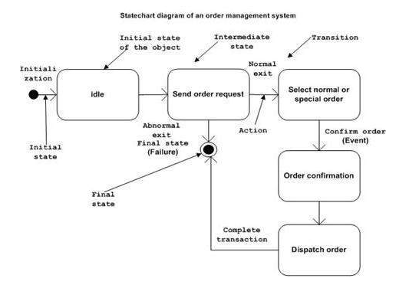
State Transition Diagram

Slide 34
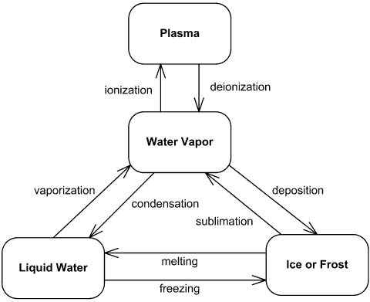
State Diagram

Slide 35
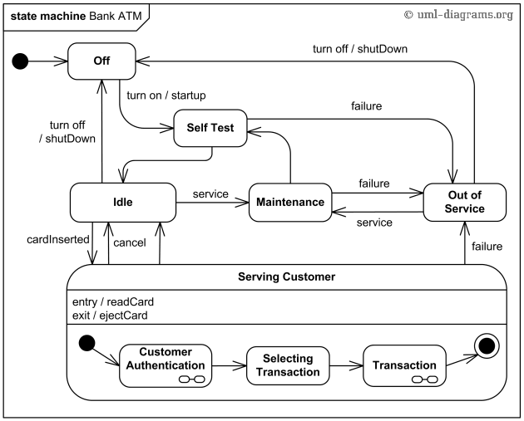

Slide 36
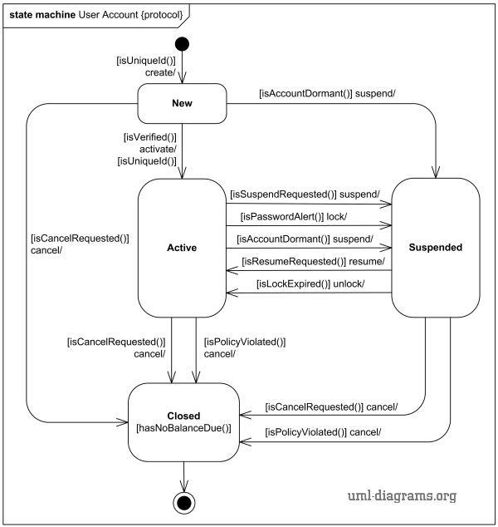

Slide 37
Activity Diagram
Activity diagram is basically a flowchart to represent the flow from one activity to another activity. The activity can be described as an operation of the system.

Slide 38
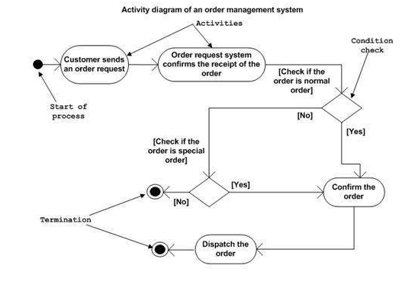
Activity Diagram

Slide 39
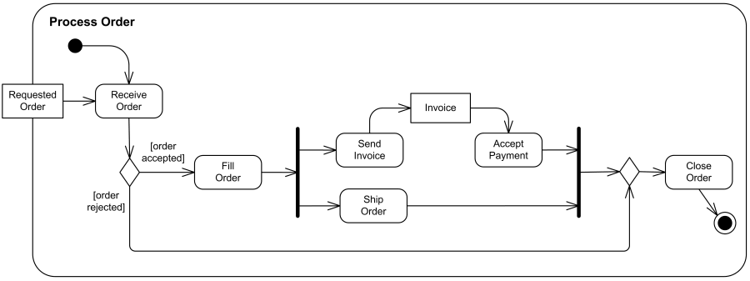
Activity Diagram

Slide 40
